Slide 1

Batch Normalization: Accelerating Deep Network Training by Reducing Internal Covariate Shift

Slide 2
Abstract
Training Deep Neural Networks is complicated by the fact that the distribution of each layer’s inputs changes during training, as the parameters of the previous layers change. This slows down the training by requiring lower learning rates and careful parameter initialization, and makes it no - toriously hard to train models with saturating nonlinearities. We refer to this phenomenon as internal covariate shift, and address the problem by normalizing layer inputs. Our method draws its strength from making normalization a part of the model architecture and performing the normalization for each training mini-batch. Batch Normalization allows us to use much higher learning rates and be less careful about initialization. It also acts as a regularizer, in some cases eliminating the need for Dropout. Applied to a state-of-the-art image classification model, Batch Normalization achieves the same accuracy with 14 times fewer training steps, and beats the original model by a significant margin. Using an ensemble of batchnormalized networks, we improve upon the best published result on ImageNet classification: reaching 4.9% top-5 validation error (and 4.8% test error), exceeding the accuracy of human raters.
Batch Normalization使うと学習が速くなるし初期値とかあまり気にしなくてよいよ

Slide 3
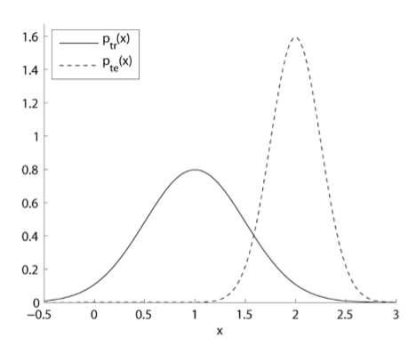
Internal Covariate Shift（内部共変量シフト）とは
入出力規則は訓練時とテスト時で変わらないが、入力（共変量）の分布が訓練時とテスト時で異なることによる問題

Slide 4
Internal Covariate Shift（内部共変量シフト）とは
訓練データ
訓練データ
テストデータ
平均０、分散１の軸
平均０、分散１の軸
平均０、分散１の軸
入力分布r(q)
入力分布r(q)
入力分布r(q)⇒r´(q´)
入力分布q(p)
入力分布q(p)
入力分布q(p)⇒q´(p)
入力分布p(μ=0,σ=1)
入力分布p(μ=0,σ=1)
入力分布p(μ=0,σ=1)⇒p

Slide 5
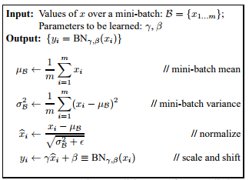
Batch Normalization
平均０、分散１の軸
データm個のミニバッチB
norm
ミニバッチの平均取得
norm
ミニバッチの分散取得
正規化
norm

Slide 6
CIFAR-10での比較
・Convolution３層、Pooling２層
Full_Connect２層
・確率的勾配降下法
・学習率0.001
network = input_data(shape=[None, 32, 32, 3],
data_preprocessing=img_prep,
data_augmentation=img_aug)
network = conv_2d(network, 32, 3, activation='tanh')
network = max_pool_2d(network, 2)
network = conv_2d(network, 64, 3, activation='tanh')
network = conv_2d(network, 64, 3, activation='tanh')
network = max_pool_2d(network, 2)
network = fully_connected(network, 512, activation='tanh')
network = fully_connected(network, 10, activation='softmax')
network = regression(network, optimizer='sgd',
loss='categorical_crossentropy',
learning_rate=0.001)

Slide 7
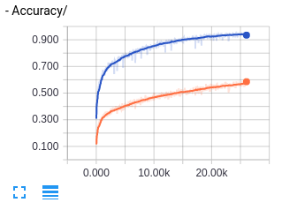
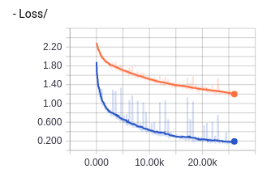
Batch Normalization適用
network = input_data(shape=[None, 32, 32, 3],
data_preprocessing=img_prep,
data_augmentation=img_aug)
network = conv_2d(network, 32, 3, activation='tanh')
network = max_pool_2d(network, 2)
network = conv_2d(network, 64, 3, activation='tanh')
network = conv_2d(network, 64, 3, activation='tanh')
network = batch_normalization(network)
network = max_pool_2d(network, 2)
network = fully_connected(network, 512, activation='tanh')
network = batch_normalization(network)
network = fully_connected(network, 10, activation='softmax')
network = regression(network, optimizer='sgd',
loss='categorical_crossentropy',
learning_rate=0.03)

Slide 8
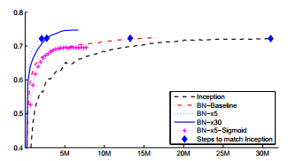
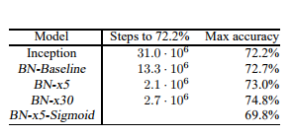
Batch Normalization適用
・LSVRC2012(AlexNet)にBatch
Normalizationを適用
・学習率30倍より5倍のほうが
規定の正解率に届くまでが速い
・学習率5倍より30倍のほうが
最終的な正解率が高い

Slide 9
まとめ
・Neural Networkについて少し詳しくなった
（勾配消失、勾配爆発）
・学習が速くなる、精度が高くなる、シビアな初期値の設定
が必要なくなる
・実装はさほど難しくないので使ってみたい

